Slide 1
Maker’s university – by intel’s makers community class 2
Gil Tal.
Jan 2020

Slide 3
Class 2 agenda:
Basic project
I/Os
Graphics fundamentals
The LCD we have on our platform
The touch panel and Joy Stick
Arcade’s team targets
Drone’s team targets
Flash memory vs EPROM
Go through the demos

Slide 4
Basic code structure in Arduino
void setup() {
// put your setup code here, to run once:
I/O set up
One time initialization function/s
}
void loop() {
// put your main code here, to run repeatedly:
Our code, runs endlessly ….
}

Slide 5
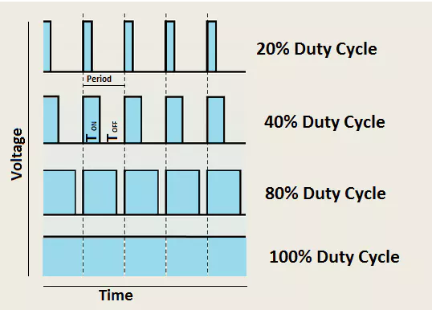
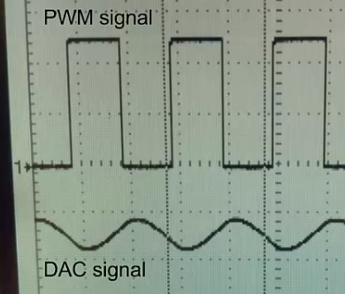
I/O and the different types
Digital type:
Setup: pinMode(34 /* IO Number */, INPUT);
Setup: pinMode(34 /* IO Number */, OUTPUT);
digitalWrite(34, HIGH); digitalWrite(34, LOW);
digitalRead(34);
Analog type:
Setup: pinMode(36, ANALOG) // Input only
analogRead(36);
PWM (Pulse-Width Modulation):
Setup: pinMode(25, OUTPUT);
Setup: ledcSetup(1/*Channel*/, 2000/*Freq*/, 8/*Number of bits for resolution of duty cycle*/);
Setup: ledcAttachPin(25, 1);
ledcWriteTone(1/*Channel*/, 2000/*Freq*/);
ledcWrite(1/*Channel*/, 196 /*Duty Cycle*/);
DAC:
No setup needed
dacWrite(25,Value /* 0 – 255 */); // Output 0-3.3V, 0.013V steps

Slide 6
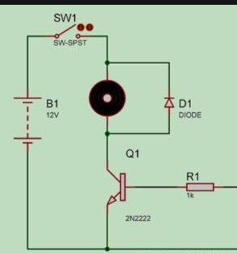
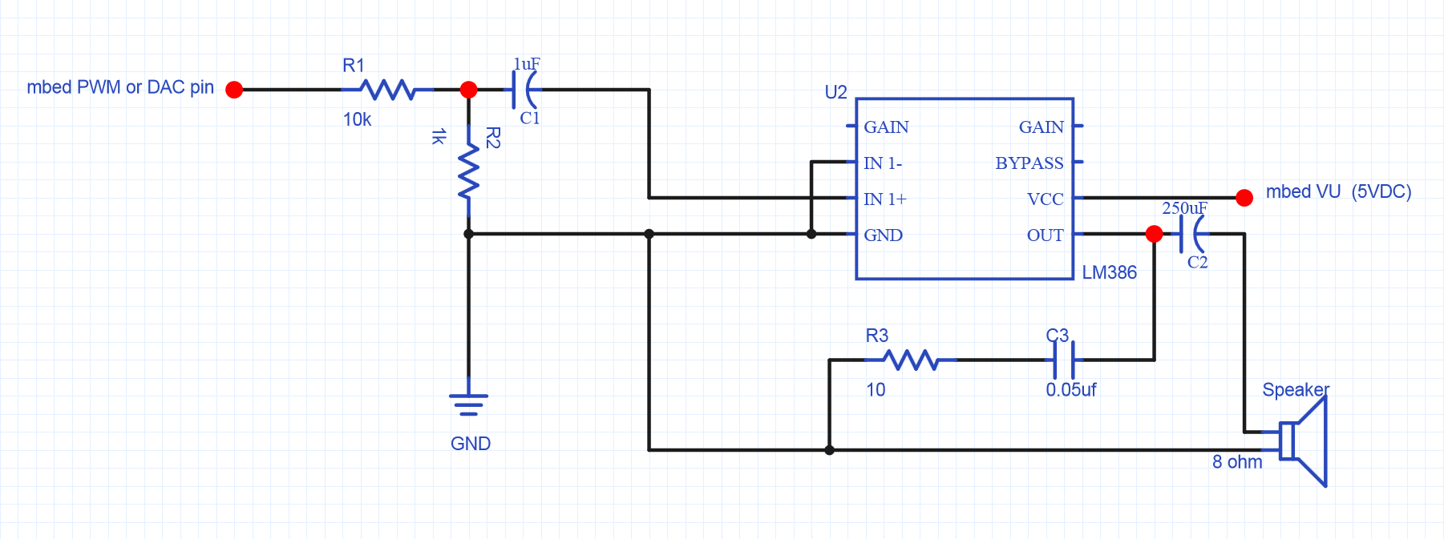
Usage for i/os
Digital: Control led, relays, read state of digital inputs coming from different devices
Analog: Read voltage level of a device, potentiometer, Joy Stick
PWM: Control a speaker, DC motors, servo electric engines and more…
DAC: Drive a speaker with volume control, generate special wave forms, use your imagination
PWM

Slide 7
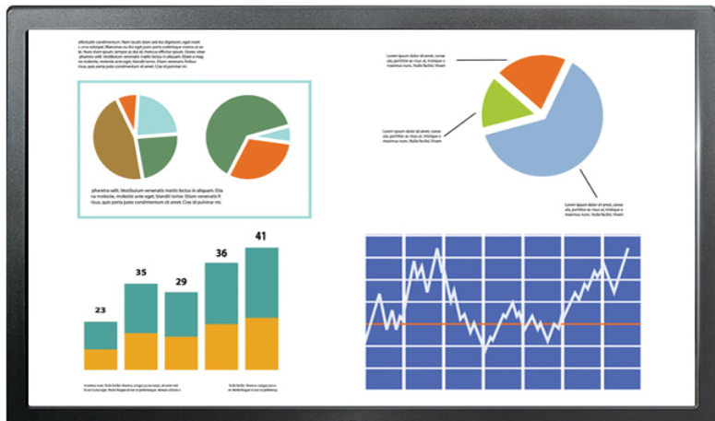
Basic graphics controller
Graphics
Memory
RGB
Graphics controller
(In our case – ILI9488)
Interface to host
PCIe, SPI, I2C,UART, Parallel …
Memory structure:
Array of: RGB,RGB,RGB …. Or (ARGB,ARGB,ARGB…)
32, 24, 18, 16, or 3 bit per pixel (8888, 888, 666, 565, 111)

Slide 8
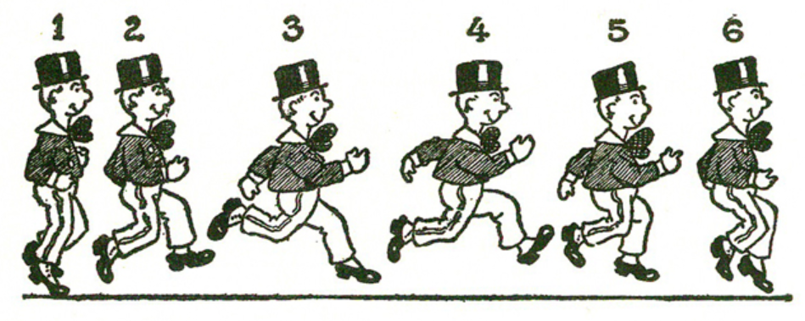
Animation basics…

Slide 9
Few main technics
Option 1: Use one frame, just erase and draw what ever is needed, do it fast enough and it will look OK
Option 2: Use a scratch frame buffer, for each scene:
Erase the frame buffer
Draw the new scene
Send the new scene to the video controller
We need a frame rate greater than 30 to have smooth animation
Option 3: Combination of options 1 and 2
Use frame buffer
just erase and draw what ever is needed
Send the frame to the video controller

Slide 10
Our LCD – ili9488 based
Support two modes using SPI
SPI running at 40MHz one bit, with additional Command\Data control
RGB666 (262K colors): 10 FPS for full screen refresh
Three bytes per pixel
RGB111 – (8 colors): 60 FPS (Arcade mode – unofficial name ☺)
Two pixels per 8 bits

Slide 11
ESP32 and the LCD block diagram
RGB666 mode – Any write of the graphics drivers access the frame buffer memory directly
ESP32
ILI9488
LCD
SPI
Frame buffer
Memory
RGB111 mode – Any write of the graphics drivers access the local frame buffer
When needed the Local frame buffer should be written to the ILI9488 frame buffer memory and only then we will see what we have written to the local frame buffer
ESP32
ILI9488
LCD
SPI
Local Frame buffer
Memory
Frame buffer
Memory

Slide 12
RGB666 (262K colors):
Graphics Memory resides in ILI9488
Every write is driven directly to the ILI9488 through the SPI interface
10 FPS
Supports image displaying of compressed 24 bit bitmaps and compressed gray scale bitmaps
How to use:
In the main file declare a global instance:
ILI9488SPI_264KC lcd(480, 320);
In the setup initialize the LCD:
lcd.init();
Sample code:
lcd.fillScr(0, 0, 0); // (R,G,B) 0-255
lcd.setColor(255, 0, 0);
lcd.drawString("LCD DEMO", 100, 100, 25);

Slide 13
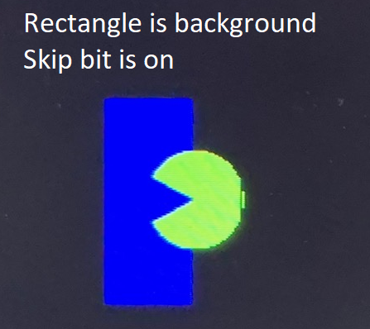
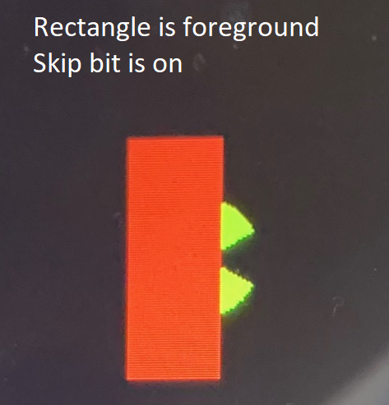
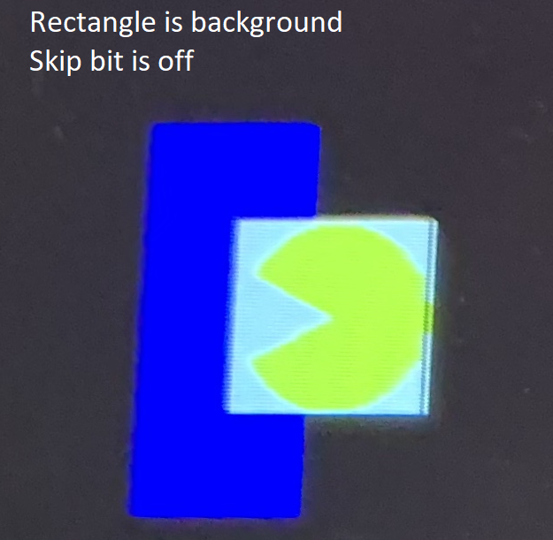
RGB111 (8 colors) – arcade mode:
Arcade gamming oriented, performance is much higher than RGB666, flicker free
Graphics memory resides in ESP32!!
Every write is NOT driven directly to the ILI9488, only when we decide a full frame is being written
60 FPS
Supports foreground and background
Supports image displaying of 8 colors bitmaps with skip and flip options

Slide 14
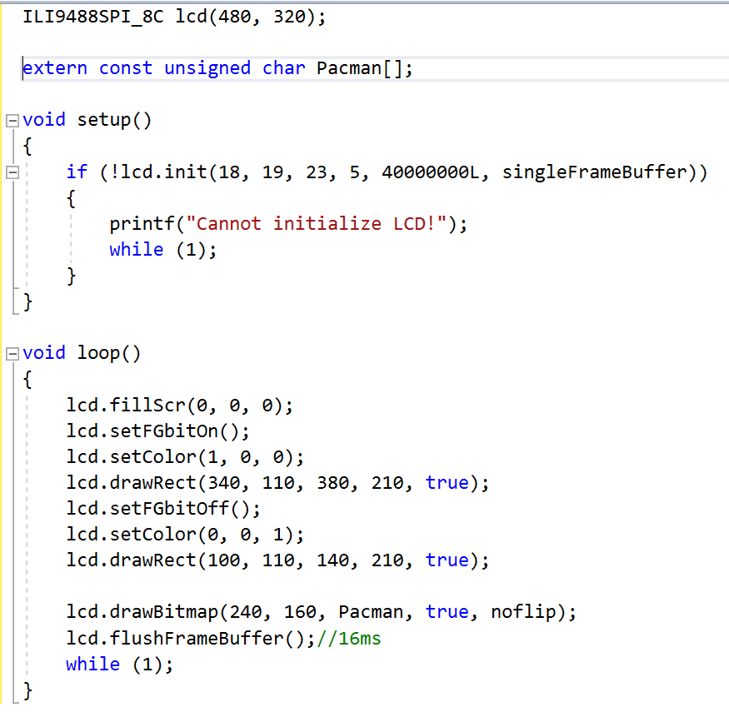
RGB111 – Arcade mode: how to use

Slide 15
Generating bitmaps and using them in our code
Pick your image, make it a BMP file with size no larger than 480x320
Use the BMPconverter.exe in the tools directory in the GIT
The tool generates a C file containing the array (bitmap)
Place the file in your project directory as is
Generate a declaration in your main file (where loop resides)
extern const unsigned char/unsigned int/unsigned short FlappyBird[];
For 262K mode use:
LCD.drawCompressed24bitBitmap(x,y, FlappyBird);
LCD. drawCompressedGrayScaleBitmap(x,y, FlappyBird)
For 8 colors mode use:
LCD. drawBitmap(x,y, FlappyBird, /*useSkipBit*/ true, /*Flip Opt.*/noflip);

Slide 16
The touch panel
Capacitive touch panel with two points
I2C interface – 100 KHz
Sensitivity can be set from few centimeters to direct touch
Interrupt driven directly to the MCU to indicate a touch
Doesn’t need an expansive I2C read to check for a touch!
No need for a calibration process!
Need to call the initialization function in setup
Usage:
Check if touched: if(TOUCH_PANNEL_TOUCHED())…
If yes: count = ts.getTouchedPoints(&x1, &y1, &x2, &y2);

Slide 17
The joy stick
Two axis – X and Y, both analog
Using I/Os: 36 and 39 and analog inputs
Each one is a bit different thus needs compensation
Usage:
analogJoyStick JS(JOY_X_PIN, JOY_Y_PIN, 5/*Dead Zone*/);
JS.init(); // When called joy stick shouldn’t be touched!!
jx = JS.readXaxis(); // Read value : -2048 to +2048

Slide 18
The speaker (buzzer)
Uses PWM channel 0
Has two functions:
One blocking: void sound(unsigned short freq, unsigned short timeInMilliSec);
Will play sound of frequency for a period of time, when done will return
Second non blocking: void sound(unsigned short freq);
Will trigger the speaker to generate sound at specified frequency and return immediately
Call: soundOff(); to shut off the speaker

Slide 19
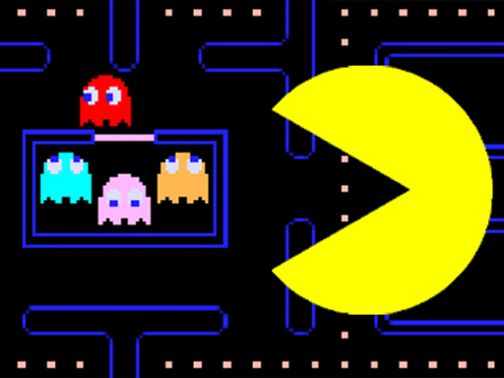
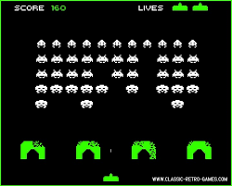
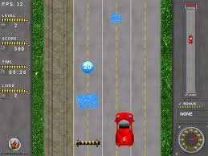
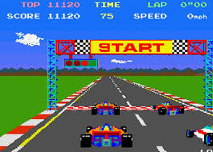
The arcade team’s targets:
Expand our graphics library to make it easier to code games
Improve the graphics library’s performance (use dual core?)
Define and code sound generating functions for games
To code few games:
Pacman (with a twist?)
Space invaders (basic code exists)
Car racing
One of our owns ☺
To define a unique controller, design it and manufacture it

Slide 20
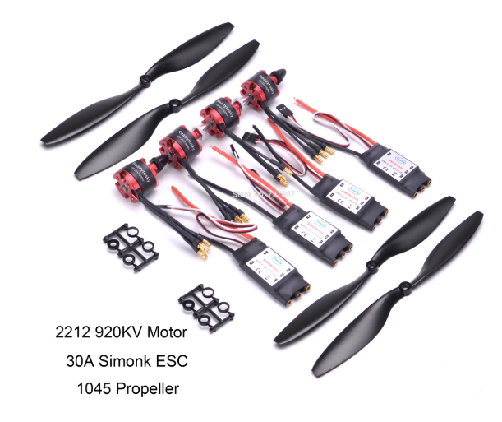
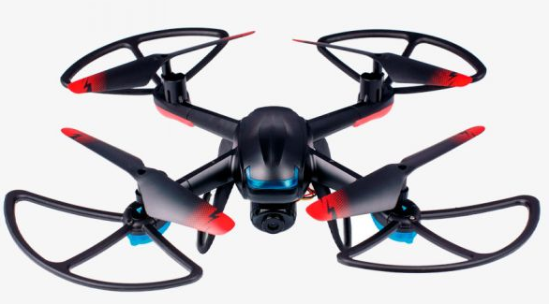
The drone team’s targets:
Design and build a complete drone
Design and manufacture the board controlling the drone
3D design and print the chassis
Code the drones flight control SW
The Arcade team will code the remote controller using our platform

Slide 21
Flash memory
Non volatile programable memory
Most common interface is SPI (1,4 or 8 bits)
Sector based (4KB, 8KB, 16KB, 64KB, 128KB) – ESP32’s flash sector size is 4KB
After erase the state of all erased bits is logic 1(0xFFFFFFFF)
We can set any bit to 0, but cannot set it back to 1 unless we erase a complete sector
Sector can be erased around 100000 times!! That’s all!!
Erase operation is long (~10ms)
Not suitable serving a memory for counters (will stop functioning after 100000 time!)
Our file system called TinyFFS is taking into account these drawbacks
Sectors can be protected

Slide 22
EEprom memory
Small sizes (2KB to 64KB)
Size to price ratio is really bad ☹
You can just write to any byte any data
Most common interface is I2C
Very slow and mostly used for saving configuration data
ESP32’s EEPROM is emulated on the main flash and is occupying one sector (4KB)
How to use:
EEPROM.begin(512); // Size up to 4096
EEPROM.write(12/*Address*/,100/*Data*/);
EEPROM.commit(); // Save the data

